Slide 1
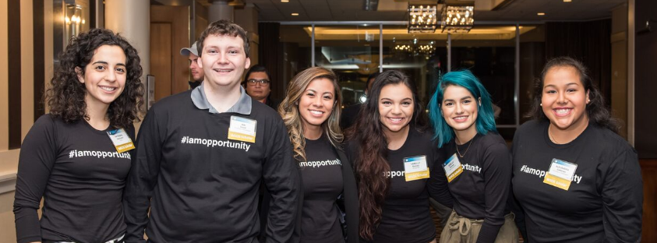
Board Meeting | December 12, 2016

Slide 2
Agenda
I. Meeting Called to Order
II. Approval of 11/1/16 Board Meeting Minutes
Key Highlights of the 2016 WSOS Legislative Report
Review of Proposed Changes to WSOS Statute for
2017 Legislative Session
Approval of 2017 Legislative Changes
WSOS Staff Report
VII. Finance Report

Slide 3
KEY FINDINGS
LEGISLATIVE REPORT 2016
December 12, 2016

Slide 4
Cohort 5 APPLICANTS

Slide 5
Applicants
More than 3,700 applications submitted
About 66% met eligibility requirements
 | 2014 | 2015 | 2016
Number of Submitted Applications | 1,507 | 2,134 | 3,779
Percent of Eligible Female Applicants | 60% | 61% | 60%
Percent of Eligible Applicants of Color | 53% | 55% | 60%
Notes:
In spring of 2016, there were 3,779 applications submitted to join WSOS C5.
Of those, 1,242 met the eligibility requirements (58%). (In 2014, about 61% of applicants met eligibility requirements.)
The majority of the eligible applicant pool were women and identified as students of color.
More than two-thirds of eligible applicants identify from races or ethnicities that are under-represented in STEM fields.
FOLLOW UP: Comparison of change in eligible applicant pool demographics from 2014 to 2015 are on the next slide.
Under-represented minorities in STEM fields include all people of color except for those identified as Asian. Pacific Islanders are considered to be under-represented minorities. (In other words, URM includes all eligible applicants except those identified as White, Not Reported, or Asian (Non-Pacific Islander).

Slide 6
Eligible Applicants
60% were female
60% identified as students of color
Represent 38 out of 39 Washington counties
Median household income of $46,534
Notes:
Both the mean and median income for C4 eligible applicants was just below $50,000.
In the graphic, you can see the distribution of eligible applicants across eligible income deciles.
When compared with 2014, there is a slight increase in the proportion of eligible applicants from the middle four deciles and a slight decrease in the proportion of eligible applicants in the bottom & top deciles.
FOLLOW UP: Highest eligible income for family of four for 2015-16 application cycle was $105K
Mean and median do not adjust for family size but deciles do.
Similar to 2014 numbers – see attached table.
Will see C4 participant incomes on a later slide – this represents eligible applicants for C4.

Slide 7
ENROLLED SCHOLARs 2016-17
Notes:
The next set of slides discuss demographics and trends across cohorts of WSOS participants and discusses Scholars who are enrolled for this academic year.

Slide 8
Cohort 5
Of 1,450 selected Scholars, 95% enrolled
1,372 C5 Scholars in 2016-17
56% are female
65% identify as students of color
Notes:
Of 1,242 eligible applicants, 1,057 were selected as C4.
By October 24, 2015, 994 of those selected C4 Scholars had enrolled to participate in C4.
The majority of enrolled C4 Scholars are women and identify as students of color.
More than two-thirds of enrolled C4 Scholars identify from races or ethnicities that are under-represented in STEM fields.
FOLLOW UP: Comparison of change in cohort demographics are on the next slide.
Under-represented minorities in STEM fields include all people of color except for those identified as Asian. Pacific Islanders are considered to be under-represented minorities. (In other words, URM includes all eligible applicants except those identified as White, Not Reported, or Asian (Non-Pacific Islander).

Slide 9
Cohort Ethnicity Over Time
Across time, WSOS Cohorts have been comprised of more students of color and more students from
under-represented minority backgrounds.
 | C1 | C2 | C3 | C4 | C5
Students of Color | 35% | 50% | 55% | 57% | 65%
Under-Represented Minorities in STEM | 15% | 31% | 31% | 35% | 39%
Notes:
WSOS cohorts are becoming increasingly racially and ethnically diverse.
Over time, WSOS cohorts have increasing proportions identifying as students of color and an increasing proportion of minorities that are under-represented in STEM fields.
This is due in part to a change in programs team efforts which have been increasingly targeting schools with more diverse student populations.
These recruitment efforts may have contributed to a more diverse applicant pool.
The increasing diversity may also be due in part to a change in selection criteria.
With newer cohorts, Scholarship Services has been taking family income into account and selecting lower income applicants.
Given that lower family incomes are often associated with communities of color, this has also possibly contributed to an increase in the diversity of cohorts across time.
FOLLOW UP: Next slide shows the breakdown by specific racial/ethnic groups across cohorts

Slide 10
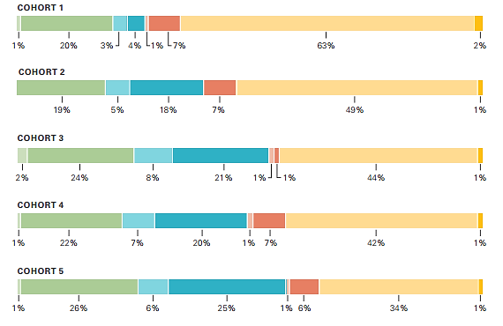
Race or Ethnicity: C1-C5
Notes:
Since C1, you can see that the proportion of white Scholars has shrunk considerably (63% to 42%)
while the proportion of Hispanic/Latino Scholars has risen (4% to 20%).

Slide 11
Cohort 5
The median and mean family income (regardless of household size) for Cohort 5 Scholars were lower than for Cohort 4 Scholars. This is likely due in part to a new selection formula used by WSOS for the 2016–17 application cycle which included the consideration of financial need.
 | 2015 | 2016
Median Household Income* | 45,979 | 38,701
Mean Family Income | 48,012 | 42,479
*Not adjusted for family size
Notes:
Both the mean and median income for C4 participants was just below $50,000.
The median and mean family incomes for C4 participants is slightly lower than that for all C4 eligible applicants we discussed earlier.
The median and mean family incomes for C4 participants is slightly higher than that for C3 participants reported in 2014.
In the graphic, you can see the distribution of C4 participants across eligible income deciles.
When compared with C4 eligible applicants, there is a slight shift in deciles (small increase in the middle & top categories):
When compared with C3 participants, there is a slight shift in deciles with an increase in the middle category and a decrease in the top & bottom categories.
FOLLOW UP: Highest eligible income for family of four for 2015-16 application cycle was $105K
Mean and median do not adjust for family size but deciles do.
Similar to 2014 numbers – see attached table.

Slide 12
Enrolled Scholars: 2016-17
Nearly 3,000 Scholars will receive funding this academic year (C1-C5)
87% attend 4-year colleges or universities
Notes:
In total, there are 2,491 Scholars from C1-C4 enrolled for the 2015-16 academic year.
Of those, 73% attend four-year colleges or universities.
It is worth noting that the increasing proportion of students you see across cohorts enrolled in two-year colleges does not represent that more students are choosing 2-year schools. Rather, it represents two realities:
First, as previously mentioned, there has been a change in recruiting efforts to target high school seniors which has led to younger cohorts.
This means that a greater proportion of later cohorts are earlier in their college careers and are therefore more likely be enrolled at a two-year school.
Second, earlier cohorts have been in college for longer than newer cohorts and therefore are more likely be in their later college years (juniors and seniors).
This means that Scholars in earlier cohorts are much morely likely to be enrolled at four-year colleges.

Slide 13
IMPACT
Notes:
In the next section, I’ll outline a brief financial summary, summarize graduates totals, and report post-graduation plans for graduates approximately nine months after graduation.

Slide 14
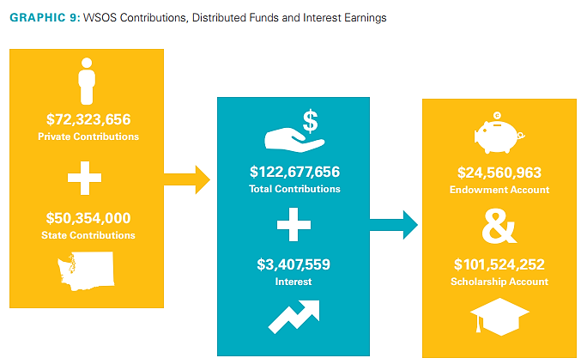
Financial Summary
More than 13,300 scholarships awarded to date
Nearly $38M in Scholarship funds disbursed by the end of 2016-17
Notes:
To date, 10,346 scholars have been awarded.
By the end of the 2015-16 academic year, $28,862,840 is anticipated to have been disbursed to Scholars all-time.
In the graphic, you can see a representation of the cash flow of WSOS funds through October 31, 2015.
This is cash-basis accounting and only reflects actual funds received and disbursed through the cut-off date.
This does not include pledge receivables of more than $34 million from private donors.
It also does not include the state’s recent $41 million appropriation for the 2015–17 Biennium.
FOLLOW UP: About $4M has been paid to CSF as program administrator

Slide 15
2015 Post-Graduation
Employed 2015 graduates demonstrated strong desirability within the workforce.
About nine out of ten (91%) graduates who sought work were employed within nine months of graduation.
The majority (72%) of 2015 graduates employed full-time within their field of study report earning between $40,000 and $79,999 per year.
Most (91%) percent of graduates employed in their field of study stayed in Washington.
Notes:
For workforce-direct graduates, 73% found employment in their field of study within nine months.
Of those who found work in their field of study, 86% are working in Washington State.
These promising outcomes demonstrate that WSOS are finding work related to their area of study and are choosing to stay in Washington State.

Slide 16
Graduates to Date
2,218 graduates
have earned
2,347 bachelor’s degrees
81%
85%
Bachelor’s Degrees in STEM or Health Care Bachelor’s Degrees in Other Fields
Notes:
Through November 1, 2015, there have been 1,481 WSOS Scholars who have received their bachelor’s degree.
Some of these earned multiple bachelor’s degrees for a total degrees earned of 1,515.
Of those 1,515 degrees, 85% (or 1,306 degrees) were earned in STEM or health care fields.
The 15% of bachelor’s degrees that are earned in non-STEM nor health care fields is explainable by two means.
First, the majority of graduates to date are from C1.
Many C1 Scholars applied and received funding under majors that are no longer deemed eligible by the WSOS Board.
A vetted and defined list of eligible majors was approved beginning with the selection of C2.
As we moved forward, C1 will comprise a smaller proportion of overall graduates.
As this happens, we expect that the number of graduates in “other” fields will also shrink.
However, some proportion of WSOS graduates will always be expected in “other” fields.
When counting graduates, we include all students who ever received funding from WSOS.
While all students who receive funding are self-declared in an eligible major at scholarship disbursement, students change majors over time.
Inevitably, some funded Scholars will change majors and go on to graduate in non-STEM and health care fields.
As C1 becomes a smaller proportion of all-time graduates and retention efforts targeting Scholar enrollment in eligible majors improve, we expect to see a drop in proportion of degrees in “Other” fields but some proportion of degrees earned will always exist.
FOLLOW UP: This is not done from the list of eligible majors but rather at the major category level for which degree families are generally considered to be STEM and/or health care.
68% of Scholars who have ever received funding have either graduated or are re-enrolled

Slide 17
Opportunity Expansion
Three proposals selected to receive the $6M in the Expansion Account
Grants were awarded in-full by WSOS by Aug. 2016
$2.2M to University of Washington’s STARS Program
$2.2M to Central Washington University’s CWUTeach Program
$1.6M to Western Washington University’s Computer Science degree program and Computer Science K-12 endorsement at WWU’s Center for Science Math and Technology (SMATE)
Notes:
Overview of Opportunity Expansion from slides.
Ask Jane Broom if she wants to add anything.

Slide 18
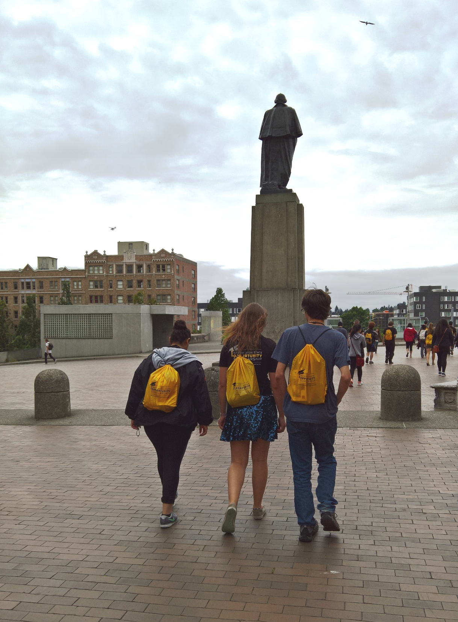
Notes:
Thank you for listening and for engaging with questions throughout the presentation.

Slide 19
Review of proposed changes to WSOs statute for 2017 legislative session
December 12, 2016

Slide 20
Proposed Changes
Professional/Technical Degree Programs
Draft language sets a separate fund for these programs “pathways” fund​
Provides funding only to approved programs offered by the State Board for Community Technical Colleges
B. Administrative Clean-Up
1. WAFSA/FAFSA issue
2. Board and Program Administrator Role
Notes:
79% of Scholars employed in FOS are working full-time

Slide 21
Approval of 2017 legislative changes
December 12, 2016

Slide 22
Staff Report
December 12, 2016

Slide 23
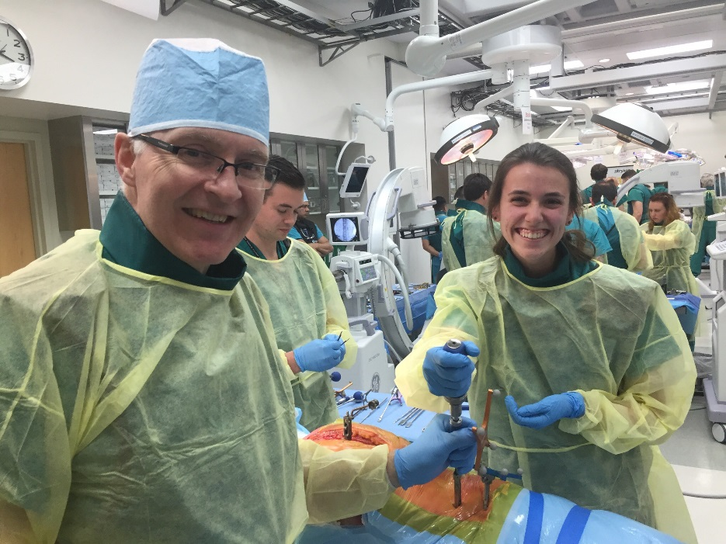
Program Update
Program:
Promotion
Retention
Career Readiness

Slide 24
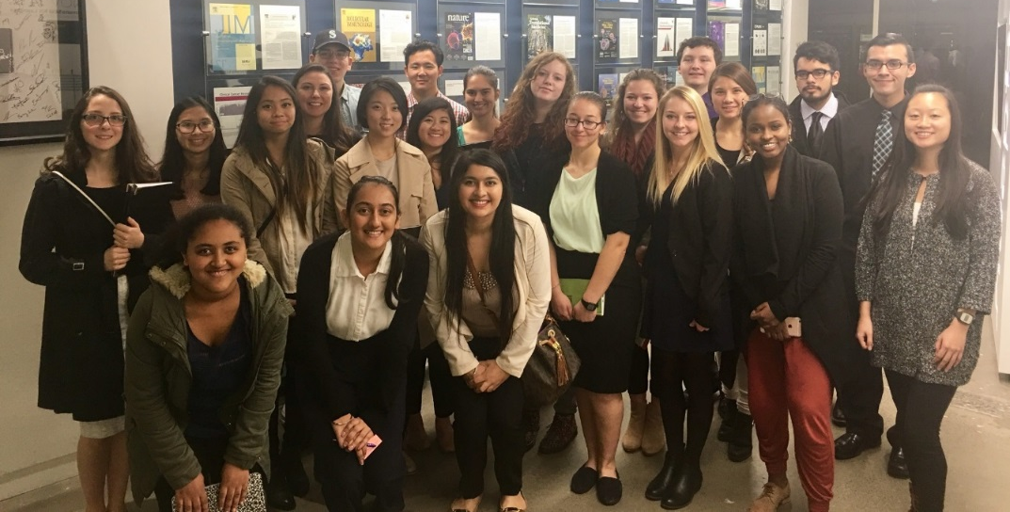
Program Administrator Selection Update
Responses to procurement process​
​
Responses reviewed on December 15​
​
Looking forward

Slide 25
Media Update
Coverage Summary:
The Power of Mentorship Helps Local College Students Shine | Geekwire, November 25
The Met Pages: OpportunityTalks | Seattle Met Magazine, January 2017

Slide 26
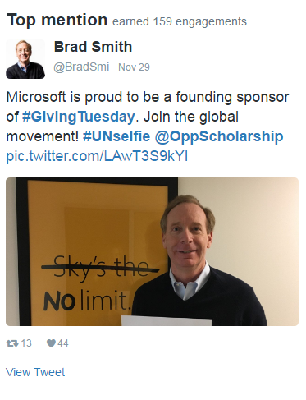
Social Media
Facebook
» 2,728 followers Oct 26, 2016
» 2,763 followers Dec 6, 2016
» Total impressions (paid & organic): 64,674
Twitter
» 1,431 followers Oct 26, 2016
» 1,439 followers Dec 6, 2016
» Total impressions (paid & organic): 9,856

Slide 27
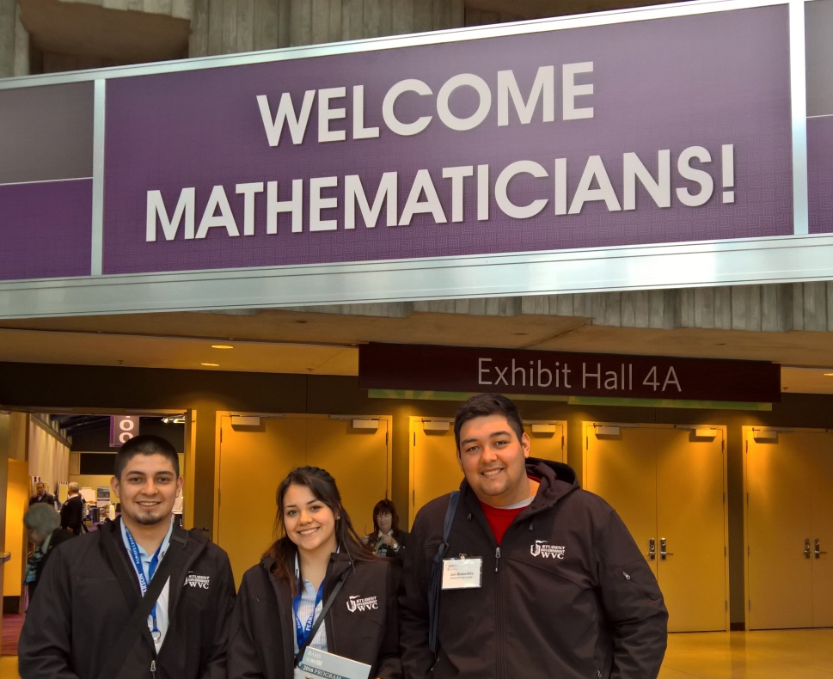
Finance UPDATE
Finance/Investment Committee Meeting | December 7, 2016

Slide 28
WSOS Balance Sheet
Washington State Opportunity Scholarship
Comparative Balance Sheets
Period Ending October 31, 2016
 |  | Comparison to FYE |  |  |  |  |  | Comparison to Same Period LFY
 |  | 06/30/2016 | % Change | 10/31/2016 |  | Notes |  | 10/31/2015 | % Change | 10/31/2016
 | Assets
 | Cash | 2,243,707 | 565% | 14,918,724 |  | 1 |  | 7,802,172 | 91% | 14,918,724
 | Investments | 85,316,061 | -15% | 72,565,725 |  | 2 |  | 55,382,689 | 31% | 72,565,725
 | Pledges and Grants Receivable | 25,428,522 | -10% | 22,815,203 |  | 3 |  | 22,478,640 | 1% | 22,815,203
 | Prepaid Expenses | 48,175 | -100% | 100 |  |  |  | 14,784 | 0% | 100
 | Total Assets | 113,036,465 | -2% | 110,299,752 |  |  |  | 85,678,284 | 29% | 110,299,752
 | Liabilities and Net Assets
 | Accounts Payable | 228,962 | 47% | 335,745 |  |  |  | 118,135 | 184% | 335,745
 | Payroll Related Liabilities | 131,958 | 32% | 174,722 |  |  |  | 143,575 | 22% | 174,722
 | Scholarship Commitments | 36,937,798 | -11% | 32,964,729 |  | 4 |  | 30,643,979 | 8% | 32,964,729
 | Total Liabilities | 37,298,718 | -10% | 33,475,195 |  |  |  | 30,905,688 | 8% | 33,475,195
 | Net Assets
 | Temporarily Restricted Net Assets | 51,700,427 | 1% | 52,153,871 |  |  |  | 36,203,667 | 45% | 52,587,066
 | Permanently Restricted Net Assets | 24,037,319 | 3% | 24,670,686 |  |  |  | 21,104,509 | 18% | 24,804,179
 | Total Net Assets | 75,737,746 | 1% | 76,824,556 |  |  |  | 57,308,176 | 35% | 77,391,245
 | Total Liabilities and Net Assets | 113,036,465 | -2% | 110,299,752 |  |  |  | 88,213,864 | 26% | 110,866,440

Slide 29
WSOS Balance Sheet
Notes to the Financials
1. Increase in Cash reflects a $14M infusion of cash from WSIB to fund scholarships and operating expenses for FY 2017.
$14M drawdown from WSIB. See note 1 above.
Pledge payments received from Rubens Family Foundation
4. $4M Scholarship payments processed this academic year to date.

Slide 30
WSOS Income Statement
 | Washington State Opportunity Scholarship
 | Income Statements
 | Income Statement for the Ten (4) Months Ending October 31, 2016
 |  |  | Four Months Ended October 31, 2016 |  |  |  |  |  | June 30, 2017
 |  |  | Actual |  | Budget |  | Variance Fav (Unfav) | Notes | Annual Budget
 | Revenue
 | Private |  | 454,340 |  | 3,700,000 |  | (3,245,660) | 1 | 11,000,000
 | Public |  | - |  | - |  | - |  | 21,000,000
 | Investment Income |  | 1,258,389 |  | - |  | 1,258,389 | 2 | -
 | Total Revenue |  | 1,712,730 |  | 3,700,000 |  | (1,987,270) |  | 32,000,000
 | Expense
 | Salaries and Benefits |  | 313,116 |  | 361,876 |  | 48,760 | 3 | 997,426
 | Program Other Direct |  | 302,982 |  | 280,683 |  | (22,299) | 4 | 610,013
 | Indirect Administrative Expenses |  | 25,593 |  | 32,063 |  | 6,471 |  | 96,190
 | Professional Fees - CSF Admin Support |  | 126,634 |  | 126,634 |  | - |  | 379,902
 | Professional Fees - Contractors |  | 28,572 |  | 33,850 |  | 5,278 |  | 102,650
 | Total Expense |  | 796,896 |  | 835,106 |  | 38,210 |  | 2,186,180
 | Net Income (Loss) |  | 915,834 |  | 2,864,894 |  | (1,949,060) |  | 29,813,820
 | Scholarships
 | Scholarship Expenses |  | 3,606,947 |  | 3,670,702 |  | 63,756 |  | 12,235,674

Slide 31
WSOS Income Statement
Notes to the Financials
Private fundraising lagging the budgeted timetable.
Unrealized gains from investment held at WSIB. We don’t budget or estimate gains and losses from investments.
Salary expense of $49k represents timing, the remaining amount represents an unfilled position.
Event expenses of $22k represents timing.

Slide 32
WSOS Cash Flow
Cash Flow Summary
Inception-To-Date
October 31, 2016
 |  |  |  | Inception - October 31, 2016
 |  |  |  | Scholarship |  | Endowment |  | Total
CASH FLOW
Cash Inflow:
 | Boeing |  |  | 12,500,000 |  | 12,500,000 |  | 25,000,000
 | Microsoft |  |  | 27,500,000 |  | - |  | 27,500,000
 | Other Private |  |  | 18,891,227 |  | 1,016,414 |  | 19,907,641
 | State |  |  | 40,354,000 |  | 10,000,000 |  | 50,354,000
 | Investment Income |  |  | 1,938,818 |  | 813,945 |  | 2,752,762
 |  | Total Cash Inflows |  | 101,184,045 |  | 24,330,359 |  | 125,514,403
Cash Outflow:
 | Scholarships |  |  | (30,557,461) |  | - |  | (30,557,461)
 | Program Expenses |  |  | (7,438,094) |  | (34,399) |  | (7,472,493)
 |  | Total Cash Outflows |  | (37,995,556) |  | (34,399) | - | (38,029,955)
 | Net Cash Flow Inception-To-Date & Balance of Cash & Investments October 31, 2016 |  |  | 63,188,489 |  | 24,295,960 | - | 87,484,449
 | WSOS US Bank Account |  |  | 14,918,723.67 |  | - |  | 14,918,723.67
 | Oppenheimer Account |  |  | - |  | - |  | -
 | Balance per WSIB October 31, 2016 |  |  | 48,269,766 |  | 24,295,960 |  | 72,565,725

Slide 33
December 12, 2016

